Slide 1



Savor the Flavor
A Culinary Journey
a Novel by
Claudia Alves

Slide 2



PIZZA ANALYSIS BY USING STRUCTURED QUERY LANGUAGE(SQL)
BY: PASAM NUTAN

Slide 3










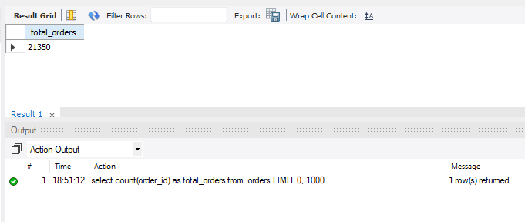








Slide 4


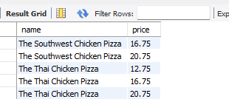
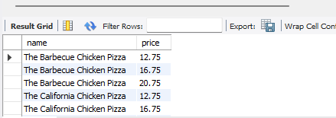
Daily Food Memo

Slide 5


Daily Food Memo

Slide 6


Daily Food Memo

Slide 7


Daily Food Memo

Slide 8
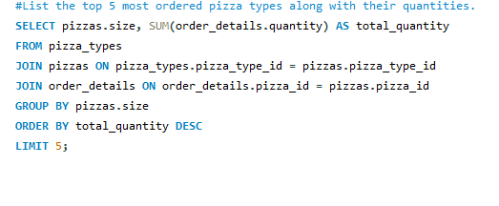

Daily Food Memo

Slide 9




Daily Food Memo

Slide 10


Daily Food Memo

Slide 11


Daily Food Memo

Slide 12


Daily Food Memo

Slide 13
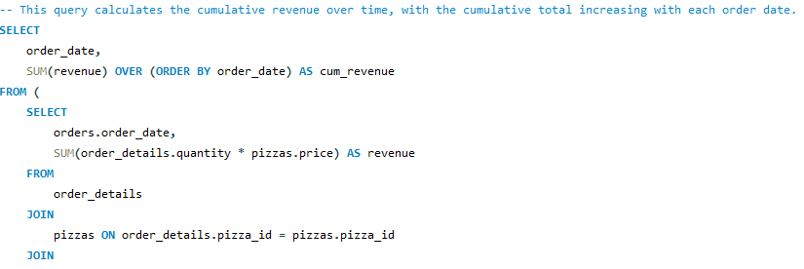
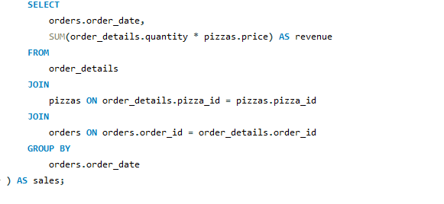


Daily Food Memo

Slide 14
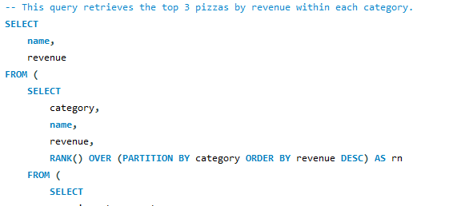
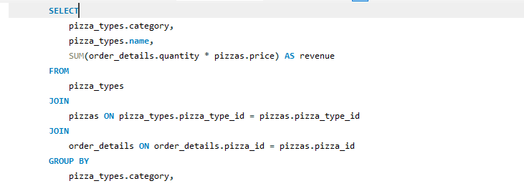



Daily Food Memo

